Slide 1

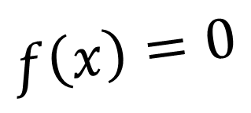
CH2120 Root-Finding: Open Methods
$$f\left(x\right)=0$$
Class 17
September 19, 2022

Slide 2
The Newton-Raphson Method

Slide 3
f(x) = 3x + sin(x) - e^{x}

Slide 4
The Newton-Raphson Method

Slide 5

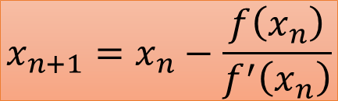
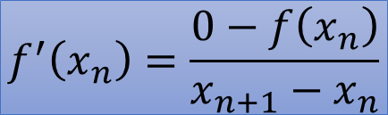


The Newton-Raphson Method
$$m=f^{′}\left(x_{n}\right)$$
$$\left(x_{n},f\left(x_{n}\right)\right)$$
$$\left(x_{n+1},0\right)$$
$$f^{′}\left(x_{n}\right)=\frac{0−f\left(x_{n}\right)}{x_{n+1}−x_{n}}$$
$$x_{n+1}=x_{n}−\frac{f\left(x_{n}\right)}{f^{′}\left(x_{n}\right)}$$

